Slide 1
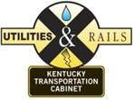
When to Involve your KYTC Rail Coordinator
September 5, 2018
Allen Rust, PE
Rail Coordinator
KYTC
Division of Right of Way and Utilities

Slide 2
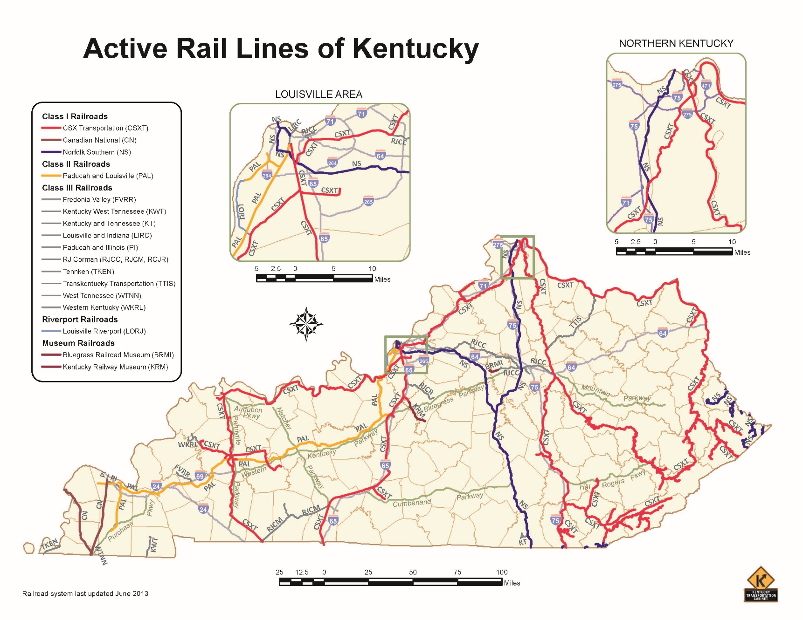
Railroads in Kentucky

Slide 3
Railroads in Kentucky
Railroad | Miles of Track in KY
CSX | 1,685
Norfolk Southern | 429
Paducah and Louisville | 280
RJ Corman | 197
Illinois Central | 98
TTI | 50
Others | 452
Total: 3,191 miles

Slide 4
Railroad Requirements
How to design for it
What to include
When to involve Rail Coordinator
When is rail coordination required
How soon to begin coordination
Railroad Coordination
Plan reviews
Agreements
ROW
Questions

Slide 5
Railroad Requirements
23’ vertical clearance
25’ horizontal clearance from centerline of track
Closer with crashwalls
RR may require new overhead bridges to span entire RR right-of-way
RR property and operations shall not be negatively impacted by the project.
Additional requirements found in RR Public Projects Manual.
“Potential to foul the tracks”

Slide 6
When to involve Rail Coordinator
When is RR coordination required
On or over RR ROW
Potential to foul the tracks
POP QUIZ

Slide 7
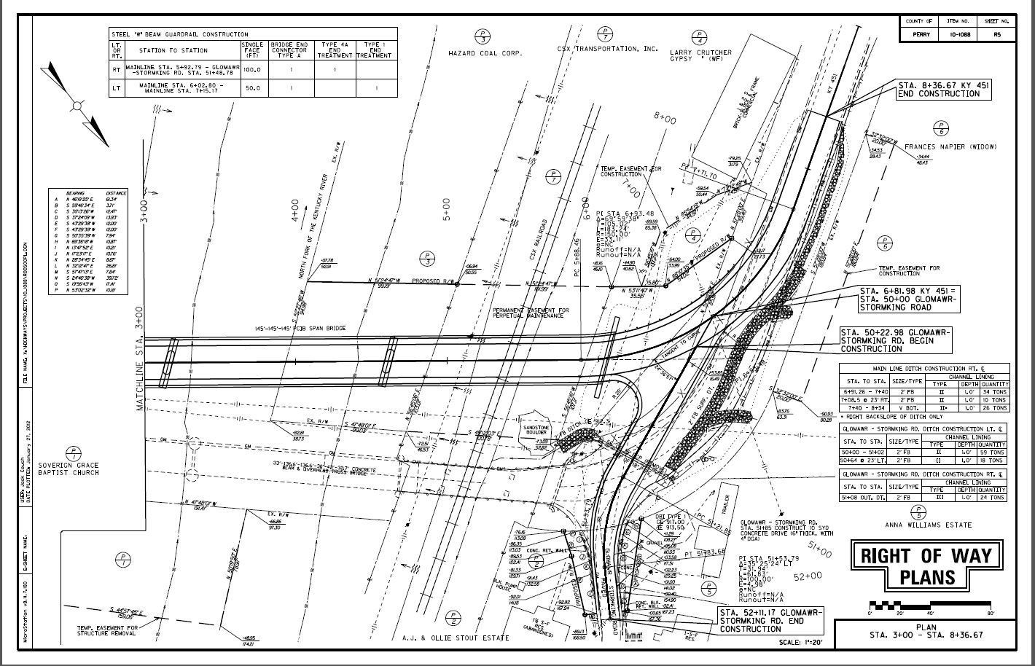
Is Rail Coordination Required?
Question 1.
Replacing existing overhead bridge at offset alignment
YES

Slide 8
Is Rail Coordination Required?
Question 2.
Bridge overlay inside barrier walls with no deck removal or joint repair
NO

Slide 9
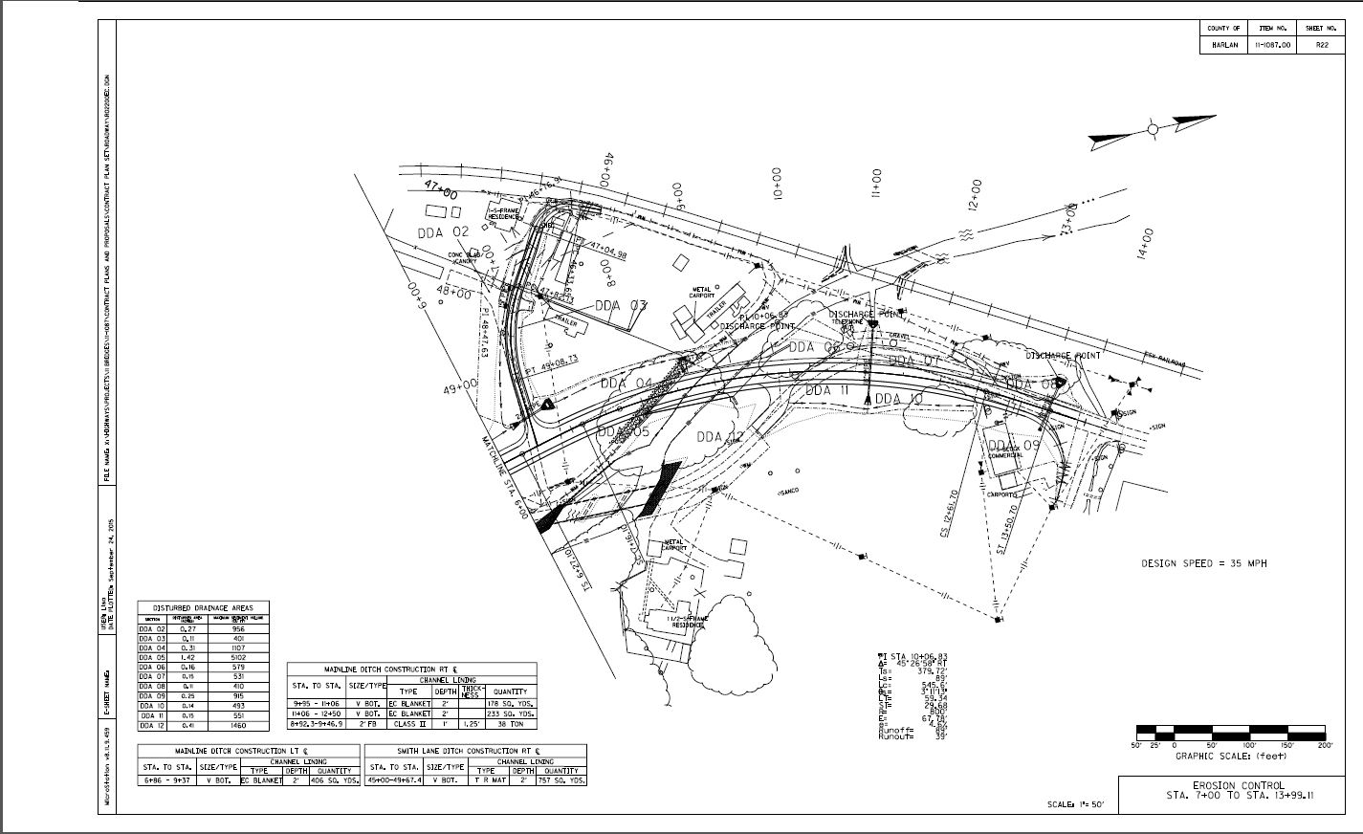
Is Rail Coordination Required?
Question 3.
Work adjacent to RR, but not on RR ROW
YES

Slide 10
Is Rail Coordination Required?
Question 4.
Bridge deck restoration with possibility of full depth patching and/or joint repair
YES

Slide 11
Is Rail Coordination Required?
Question 5.
Asphalt resurfacing at RR crossing
YES

Slide 12
Is Rail Coordination Required?
Question 6.
Work near RR, but not on RR ROW
MAYBE

Slide 13
When to involve Rail Coordinator
When is RR coordination required
On or over RR ROW
Potential to foul the tracks
ASK
When to start coordination
As early as possible
Once plans are available

Slide 14
Railroad Coordination
Acquire Right of Way
Coordinate plan review with RR companies
Coordinate flagging to protect RR facilities
Ensure that Cabinet contractors perform to standards

Slide 15
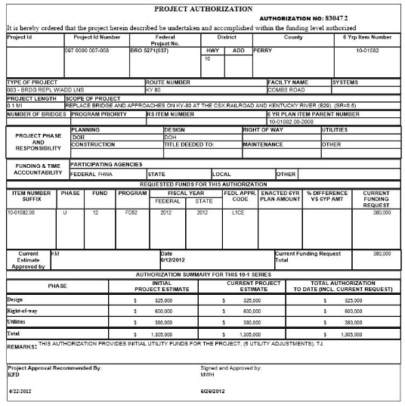
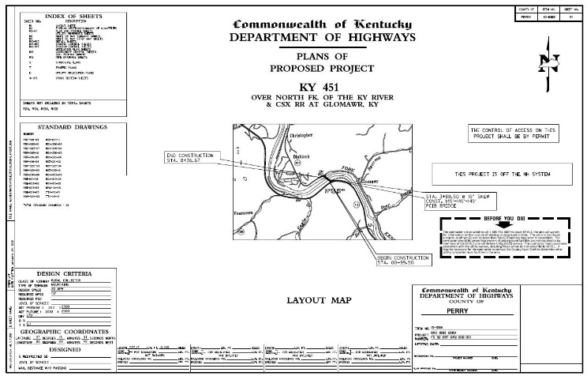
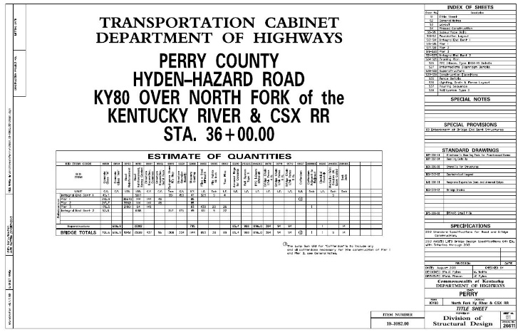
Initial Submittal
Funding
Primarily U
Can use D or C
Preliminary Road Plans
Preliminary Structure Plans

Slide 16
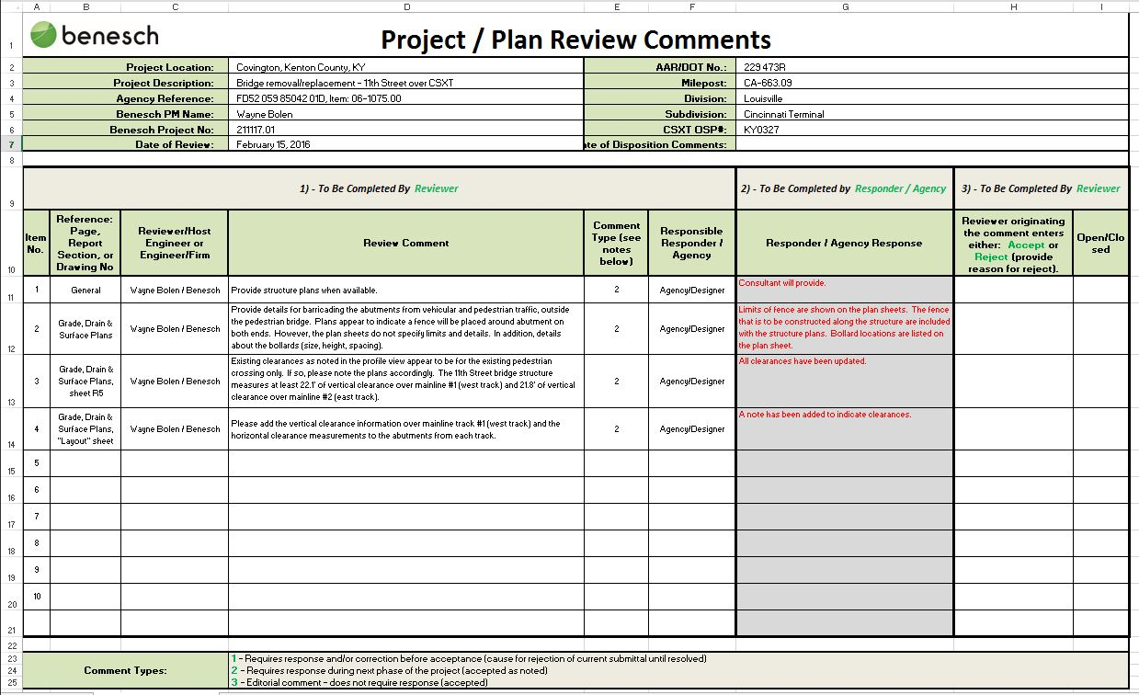
Comments Exchange
Railroad returns comments
Comment Spreadsheet
Designers address comments
Send revised plans to RR

Slide 17
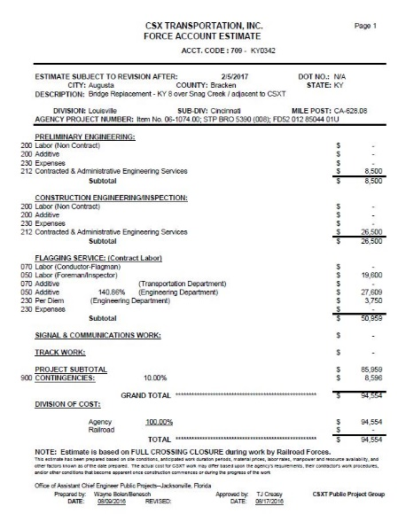
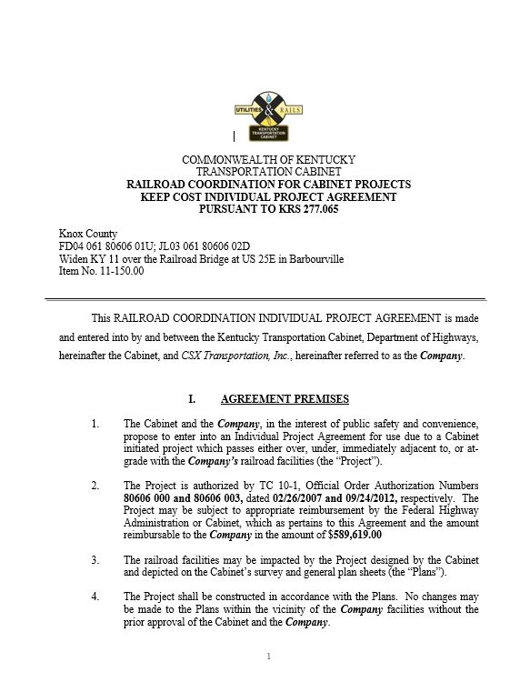
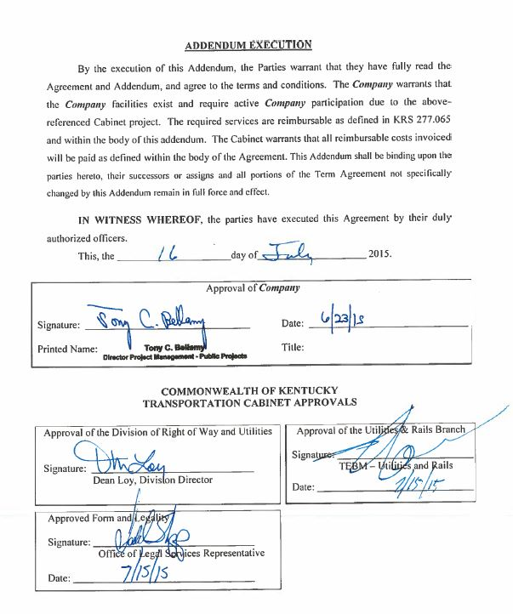
Agreement
Force Account Estimate (FAE)
Draft Agreement
Execution

Slide 18
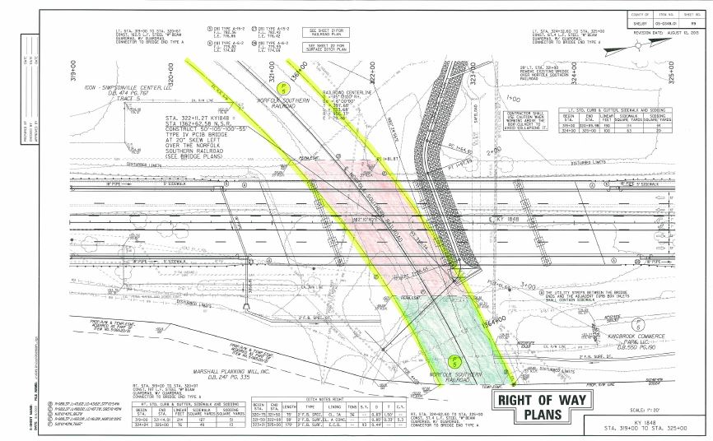
Right of Way
Offer
Offer to Purchase
MAR/Valuation
MOU
Plan Sheets
Deed Description
Payment
Recording

Slide 19
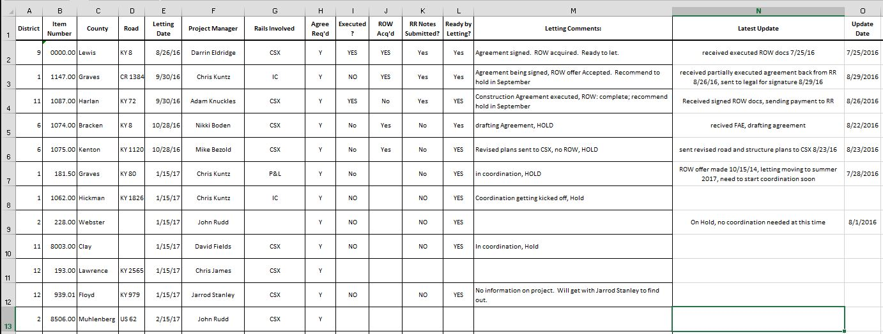
Changes
Preliminary Engineering Agreements
Flagging Note
Railroad Coordination Update

Slide 20
Questions?
Allen Rust, PE
Rail Coordinator
KYTC
Allen.Rust@KY.gov
502-782-4950

